Slide 1
Chapter 5
The Filesystem

Slide 2
Outline
File System Architecture
Pathname
File Tree
Mounting
File Types
inode and file
Link
File Access Mode
Changing File Owner
FreeBSD bonus flags

Slide 3
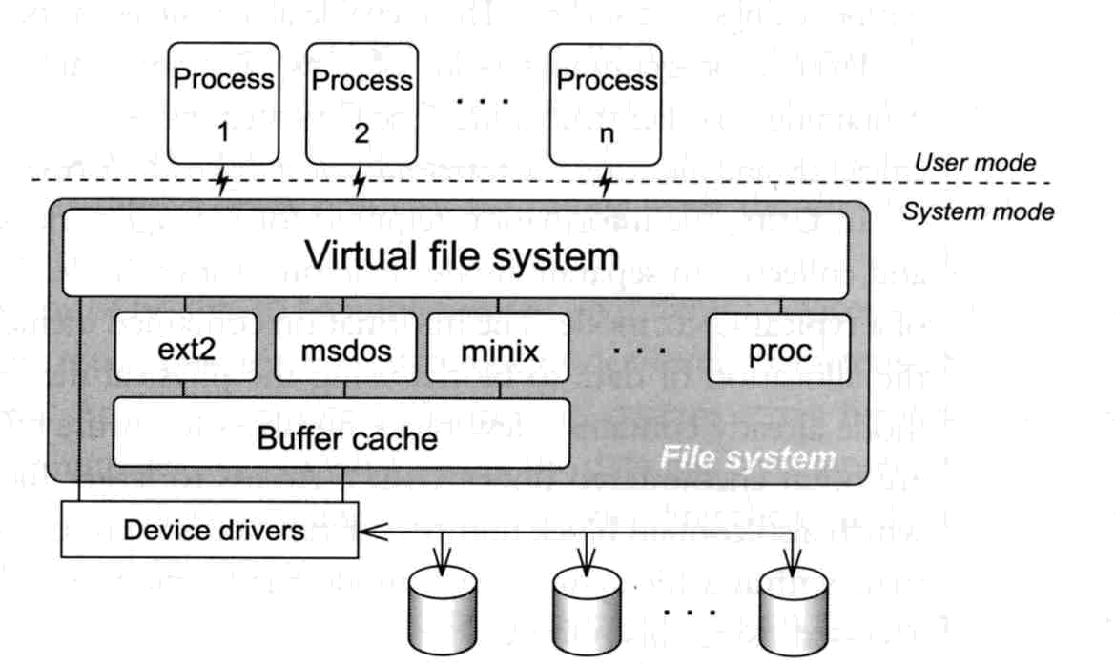
File System Architecture (1)
Application ⬄ Kernel ⬄ Hardware
  Applications call system-calls to request service
  Kernel invokes corresponding drivers to fulfill this service

Slide 4
File System Architecture (2)
The basic purpose of filesystem
  Represent and organize the system’s storage
  Four main components:
    Namespace
      A way of naming things and arranging them in a hierarchy
    API
      A set of system calls for navigating and manipulating nodes
    Security model
      A scheme for protecting, hiding and sharing things
    Implementation
      Code that ties the logical model to an actual disk

Slide 5
File System Architecture (3)
Objects in the filesystem:
  What you can find in a filesystem:
    Files and directories
    Hardware device files
    Processes information
    Interprocess communication channel
    Shared memory segments
  We can use common filesystem interface to access such “object”
    open、read、write、close、seek、ioctl…

Slide 6
pathname
Two kinds of path
  Absolute path ➔ start from /
    Such as /u/gcp/92/9217810/test/hehe.c
  Relative path ➔ start from your current directory
    Such as test/hehe.c
Constrains of pathname
  Single component: ≦ 255 characters
  Single absolute path: ≦ 1023 characters

Slide 7
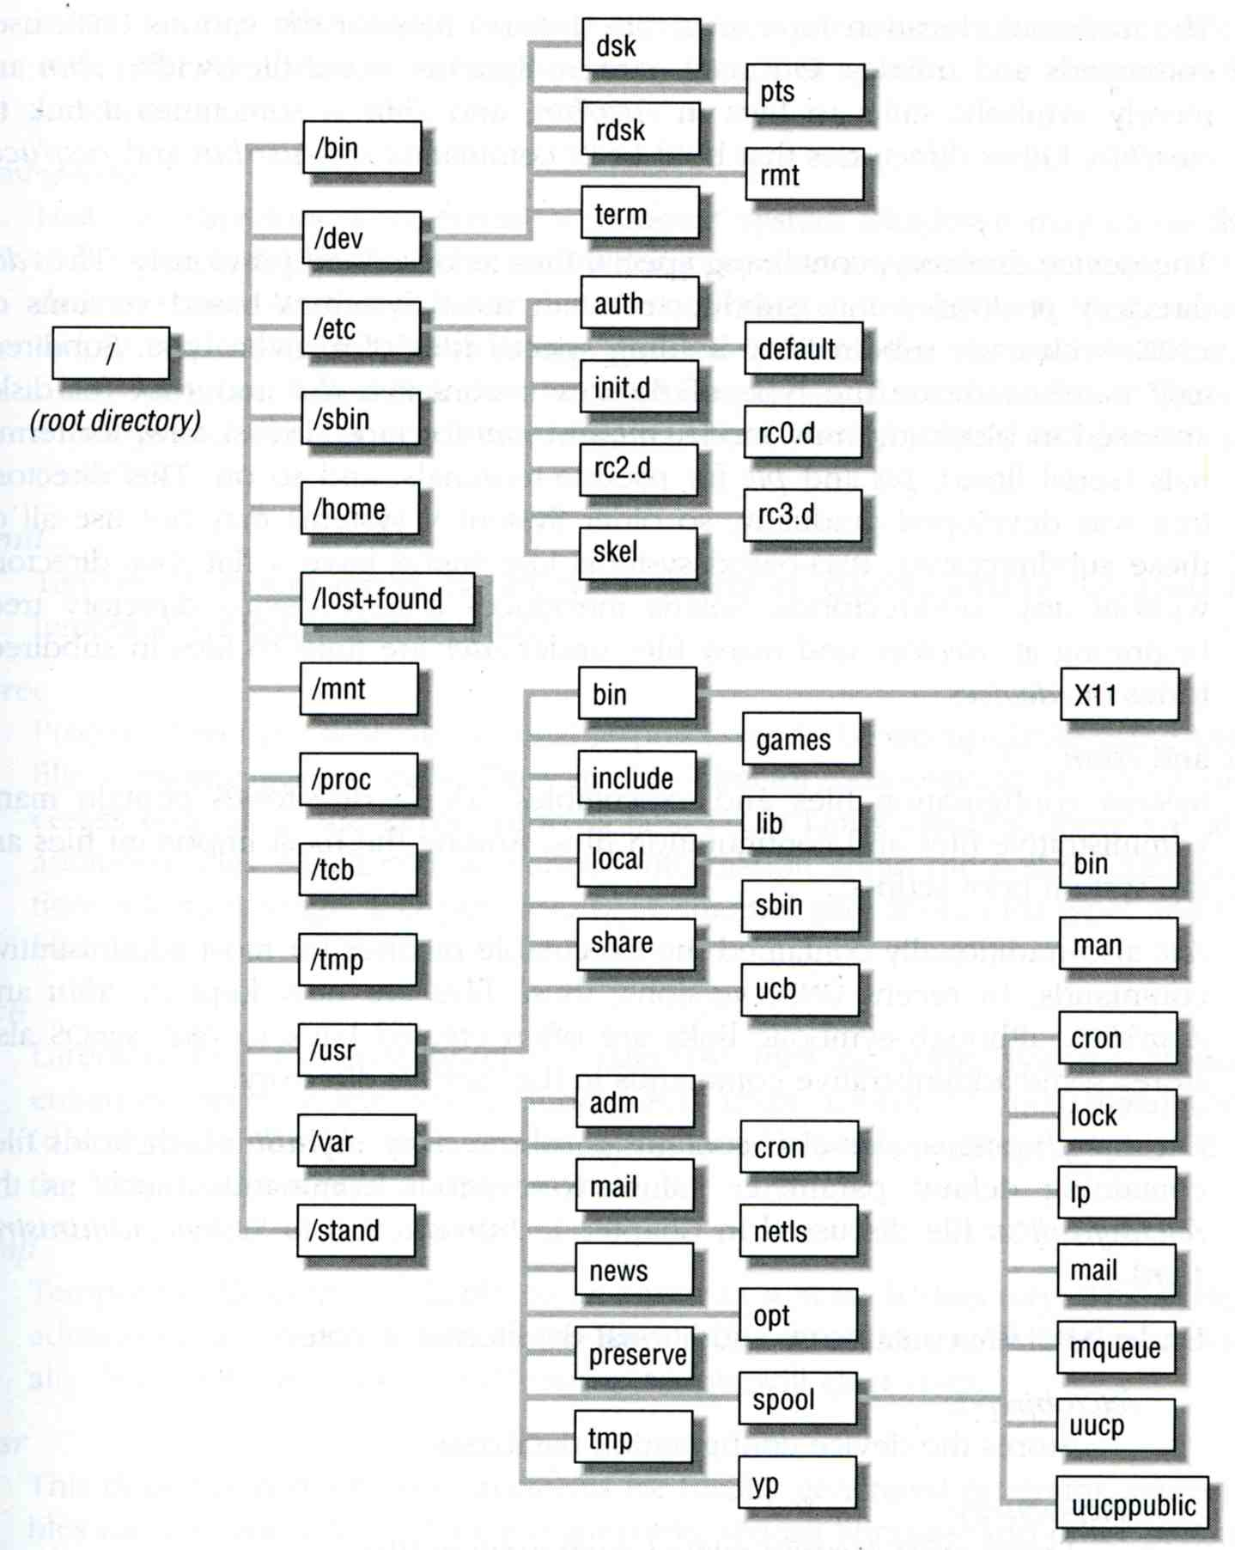
File Tree (1)

Slide 8
File Tree (2)
standard directories and their contents
pathname | Contents
/ | The root directory
/bin or /sbin | Commands needed for minimal system operability
/usr/bin | Executable files
/usr/local/bin | Local executable
/usr/local/sbin | Local system maintenance commands
/etc | Critical startup and configuration files
/usr/local/etc | Local system configuration files
/dev | Device entries for disks, terminals, modems, etc
/proc | Images of all running process
/usr/lib | Support libraries for standard UNIX programs
/usr/include | Libraries Header files
/var/log | Various system log files
/var/spool | Spooling directories for printers, mails, etc

Slide 9
Mounting file system (1)
The filesystem in composed of chunks
  Most are disk partitions
  Network file servers
  Memory disk emulators
  Kernel components
  Etc,…
“mount” command
  Map the mount point of the existing file tree to the root of the newly attached filesystem
  % mount /dev/ad2s1e /home2
  The previous contents of the mount point become inaccessible

Slide 10
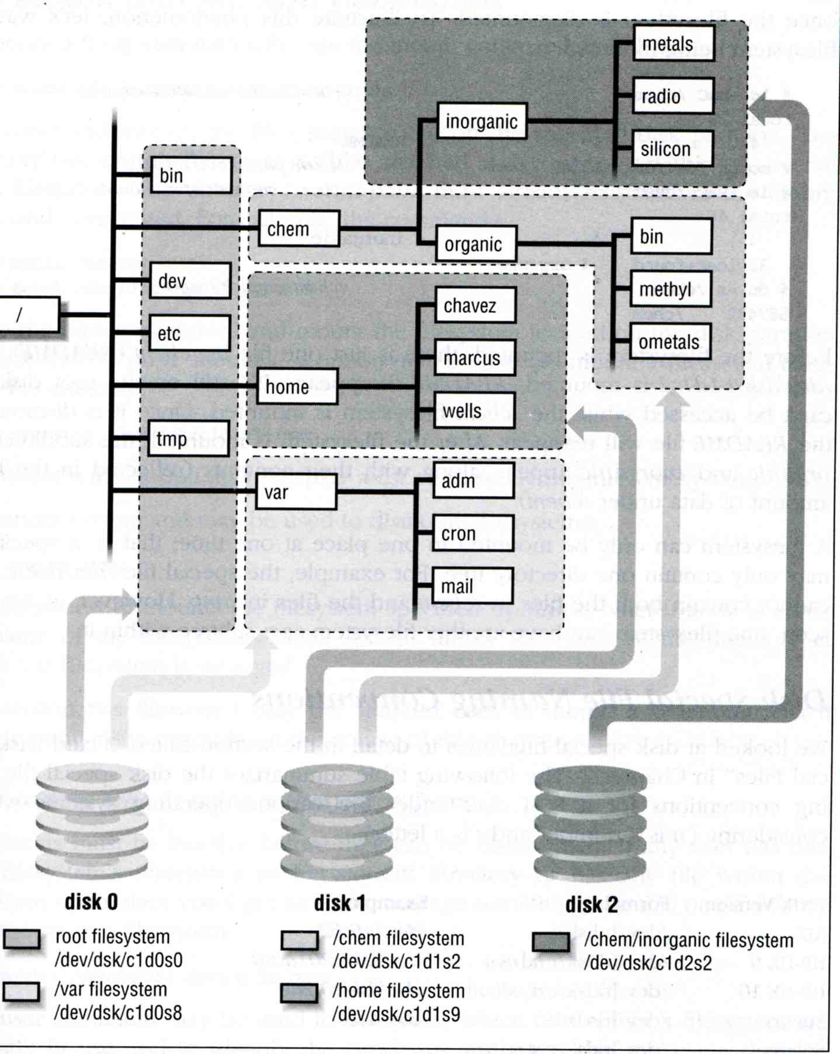
Mounting file system (2)
Example

Slide 11
Mounting file system (3)
Filesystem table – fstab
  Automatically mounted at boot time
  /etc/fstab
    Filesystem in this file will be checked and mounted automatically at boot time
Ex. bsd1’s /etc/fstab
# Device Mountpoint FStype Options Dump Pass#
/dev/ad0s1b none swap sw 0 0
/dev/ad0s1a / ufs rw 1 1
/dev/ad0s1e /backup ufs rw 2 2
/dev/ad0s1d /home ufs rw 2 2
/dev/acd0 /cdrom cd9660 ro,noauto 0 0
csduty:/bsdhome /bsdhome nfs rw,noauto 0 0

Slide 12
Mounting file system (4)
Unmounting File Stsyem
  “umount” command
    % umount node | device
      Ex: umount /home, umount /dev/ad0s1e
  Busy filesystem
    Someone’s current directory is there or there is opened file
    Use “umount –f”
    We can use “lsof” or “fstat” like utilities to figure out who makes it busy

Slide 13
Mounting file system (5)
lsof, fuser and fstat commands
  lsof (/usr/ports/sysutils/lsof) – list open files
  fuser (/usr/ports/sysutils/fuser)
    – list IDs of all processes that have one or more files open
  fstat (FreeBSD)
% lsof /home/chwong
COMMAND PID USER FD TYPE DEVICE SIZE/OFF NODE NAME
lsof 27097 root cwd VDIR 0,75 512 730114 /home/chwong
lsof 27098 root cwd VDIR 0,75 512 730114 /home/chwong
tcsh 44998 chwong cwd VDIR 0,75 512 730114 /home/chwong
sh 55546 mysql cwd VDIR 0,75 512 730114 /home/chwong
tcsh 99025 chwong cwd VDIR 0,75 512 730114 /home/chwong
% fuser /home/chwong
/home/chwong: 55546c 44998c 99025c 27169c
% fstat /home/chwong
USER CMD PID FD MOUNT INUM MODE SZ|DV R/W NAME
chwong fstat 27101 wd / 730114 drwxr-xr-x 512 r /home/chwong
chwong tcsh 99025 wd / 730114 drwxr-xr-x 512 r /home/chwong
chwong tcsh 44998 wd / 730114 drwxr-xr-x 512 r /home/chwong
mysql sh 55546 wd / 730114 drwxr-xr-x 512 r /home/chwong

Slide 14
File Types (1)
File types
  Regular files
  Directories
    Include “.” and “..”
  Character and Block device files
  UNIX domain sockets
  Named pipes
  Symbolic links

Slide 15
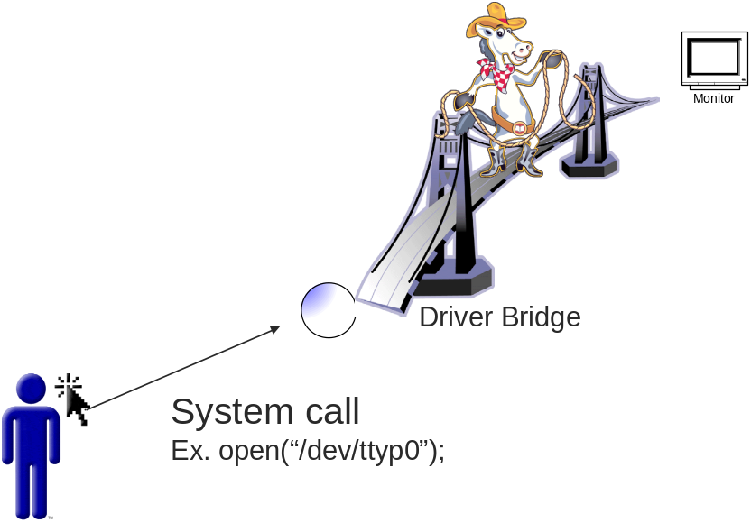
File Types (2)
character and block device files
  Use “mknod” to build special file
    % mknod name [c|b] major minor
      The same major number will use the same driver
drivers
major
capabilities
1
2
…
Major =5
Minor = 0
5
open,read,write,…
…

Slide 16
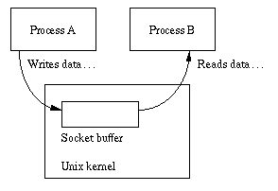
File Types (3)
UNIX domain socket
  Created by socket()
  Local to a particular host
  Be referenced through a filesystem object rather than a network port

Slide 17
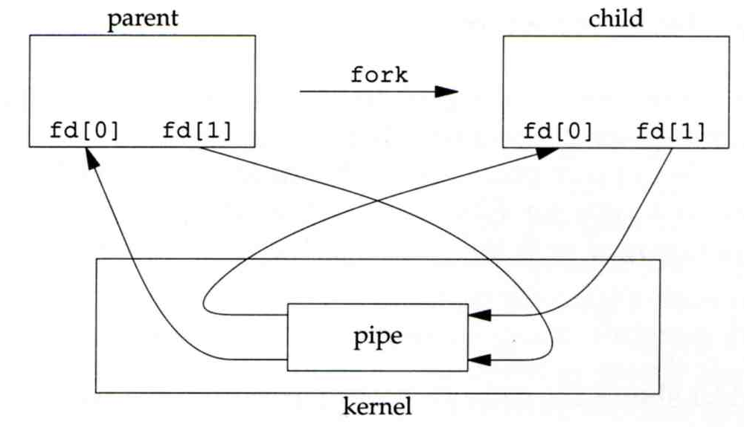
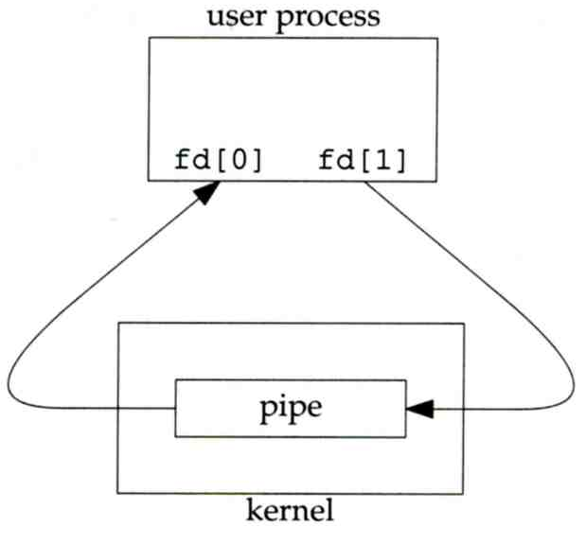
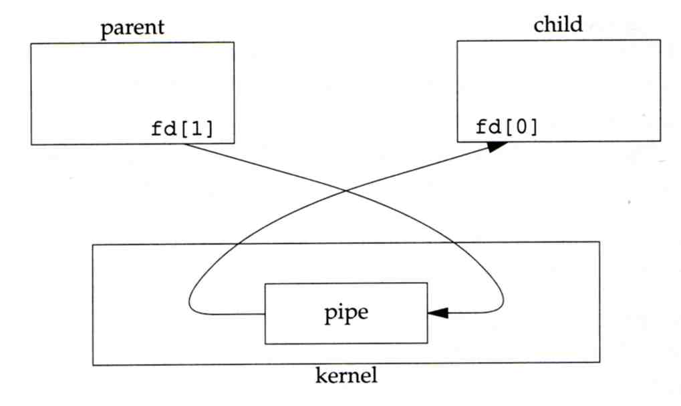
File Types (4)
Named Pipes
  Let two processes do “FIFO” communication

Slide 18
File Types (5)
Symbolic Link
  A file which points to another pathname
  % ln –s ori-file soft-file
  Like “short-cut” in Windows

Slide 19
File Types (6)
File type encoding used by ls
File type | Symbol | Created by | Removed by
Regular file | - | editors, cp, etc | rm
Directory | d | mkdir | rmdir
Character device file | c | mknod | rm
Block device file | b | mknod | rm
UNIX domain socket | s | socket(2) | rm
Named pipe | p | mknod | rm
Symbolic link | l | ln -s | rm
chwong@chbsd:/var/run> ls -al
total 36
drwxr-xr-x 6 root wheel 512 Oct 2 23:32 .
drwxr-xr-x 22 root wheel 512 Oct 1 05:00 ..
srw-rw-rw- 1 root wheel 0 Sep 30 21:00 log

Slide 20
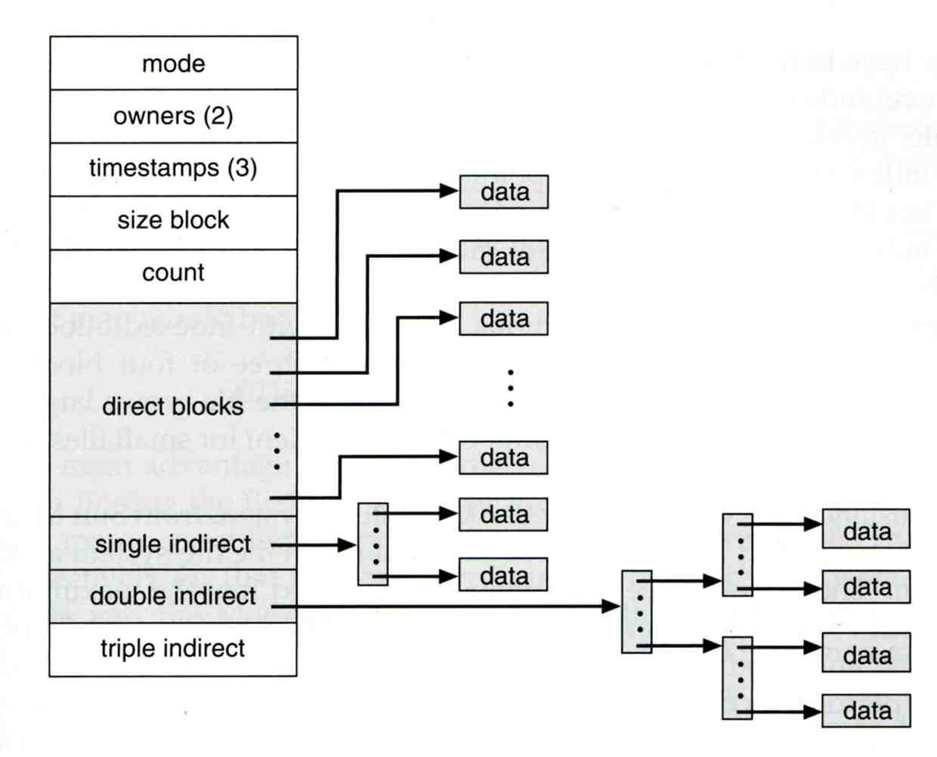
inode and file (1)
inode
  A structure that records information of a file
    You can use “ls –il” to see each file’s inode number

Slide 21
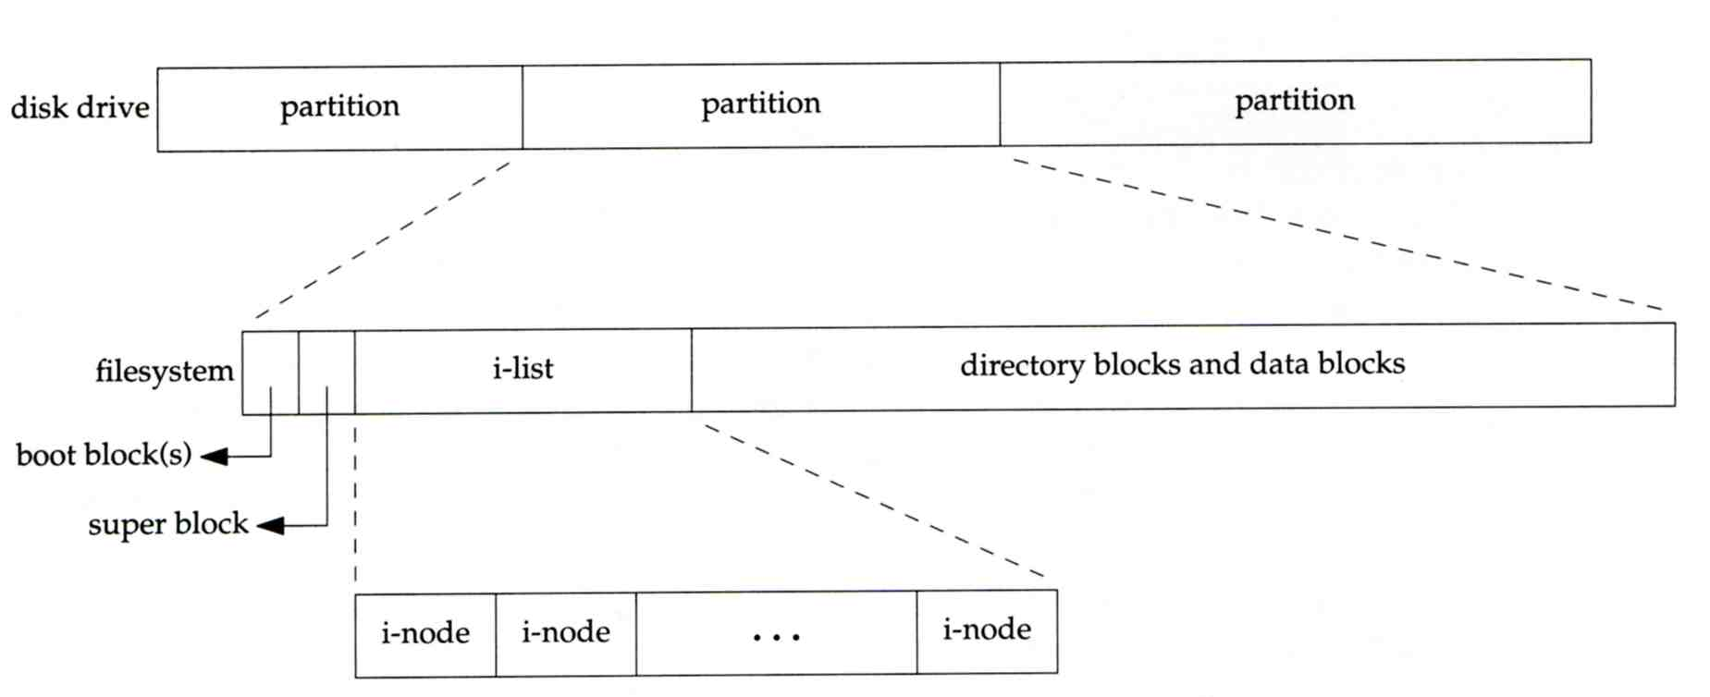
inode and file (2)
  Filesystem
    Boot blocks
    Super block
    Inode list
    Data block

Slide 22
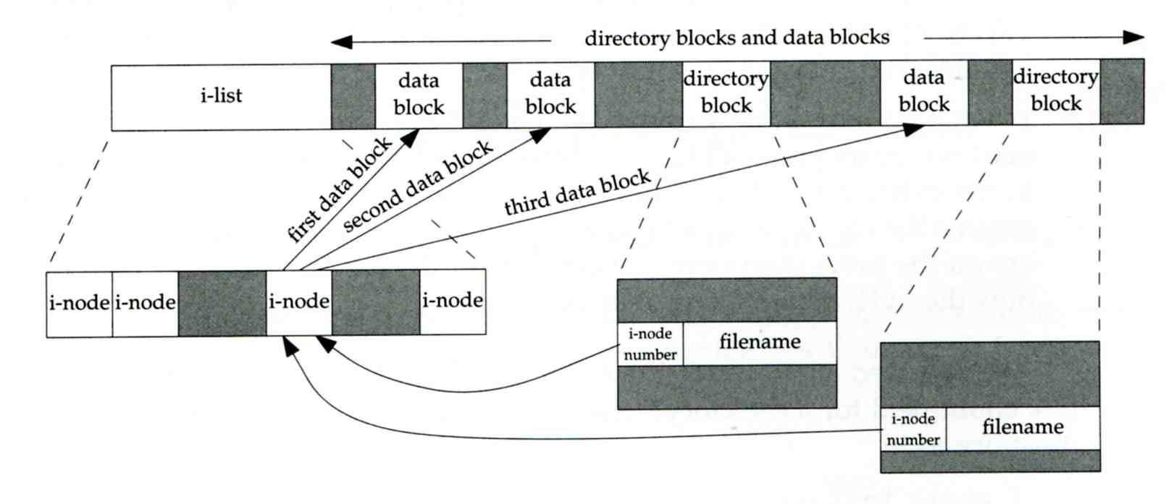
inode and file (3)
  More detail of inode and data block

Slide 23
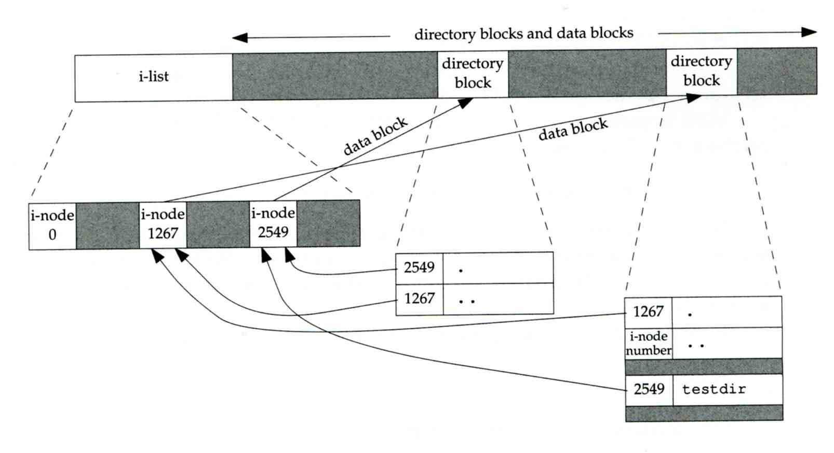
inode and file (4)
Example
  .
  ..
  testdir
testdir
chwong
/home/chwong/testdir

Slide 24
Hard Link V.S. Symbolic Link (1)
Link
  Hard link
    associate two or more filenames with the same inode
    % ln ori-file hard-file
  Soft (symbolic) link
    A file which points to another pathname
    % ln –s ori-file soft-file

Slide 25
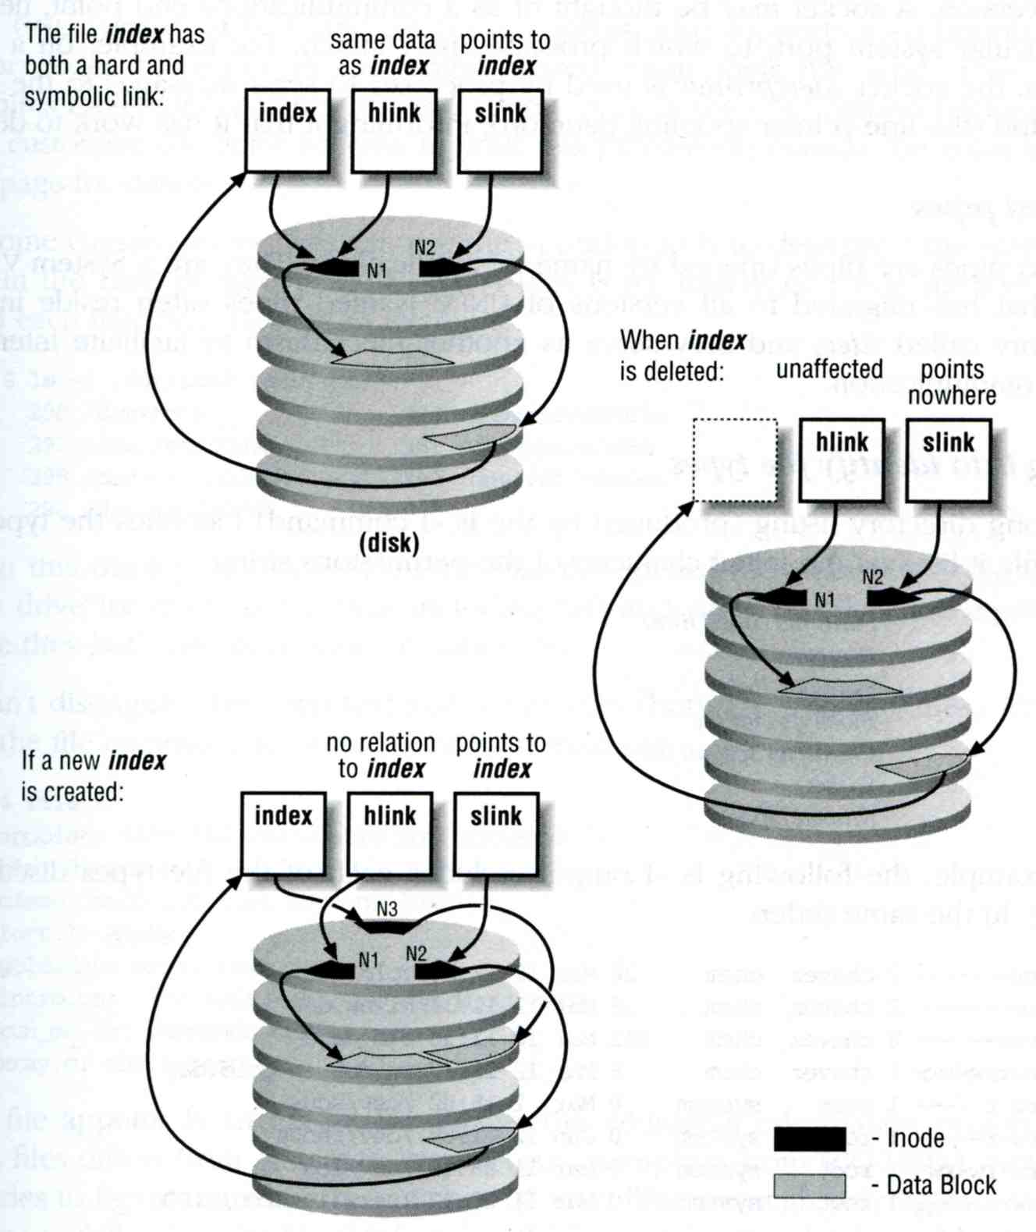
Hard Link V.S. Symbolic Link (2)
% touch index
% ln index hlink
% ln –s index slink

Slide 26
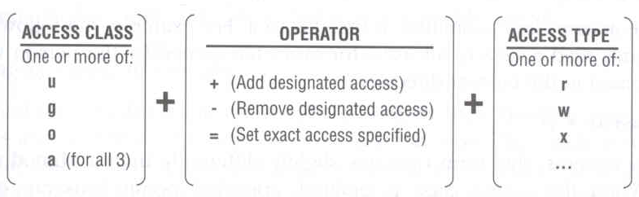
File Access Mode (1)
rwx r-x r-x
  User, group, other privileges
chmod command
  % chmod access-string file
    % chmod u+x test.sh
    % chmod go-w .tcshrc
    % chmod u+w,r-w hehe haha
    % chmod –R 755 public_html/

Slide 27
File Access Mode (2)
setuid, setgid, sticky bit
  setuid, setgid on file
    The effective uid/gid of resulting process will be set to the UID/GID of the file
    setuid
      passwd, chsh, crontab
    setgid
      top, fstat, write
  setgid on directory
    Cause newly created files within the directory to be the same group as directory
  sticky on directory
    Do not allow to delete or rename a file unless you are
      The owner of the file
      The owner of the directory
      root

Slide 28
File Access Mode (3)
Decimal argument of chmod
  setuid: 4000
  setgid: 2000
  stiky : 1000
Mode | Attribute | Mode | Attribute
755 | - rwx r-x r-x | 644 | - rw- r-- r--
4755 | - rws r-x r-x | 600 | - rw- --- ---
2755 | - rwx r-s r-x | 400 | - r-- r-- r--
2775 | d rwx rws r-x | 1777 | d rwx rwx rwt
755 | d rwx r-x r-x | 4555 | - r-s r-x r-x
750 | d rwx r-x --- | 711 | - rwx --x --x
700 | d rwx --- --- | 711 | d rwx --x --x

Slide 29
File Access Mode (4)
Assign default permissions: umask
  Shell built-in command
  Inference the default permissions given to the files newly created.
  The newly created file permission:
    Use full permission bit (file: 666, dir: 777) xor umask value.
  Example:
umask | New File | New Dir
022 | - rw- r-- r-- | d rwx r-x r-x
033 | - rw- r-- r-- | d rwx r-- r--
066 | - rw- --- --- | d rwx --x --x
000 | - rw- rw- rw- | d rwx rwx rwx
477 | - r-- --- --- | d r-x --- ---
777 | - --- --- --- | d --- --- ---

Slide 30
Changing File Owner
Changing File Owner
  Commands:
    chown -- change user owner
    chgrp -- change group owner
Change the file ownership and group ownership
  % chown –R chwong /home/chwong
  % chgrp –R cs /home/chwong
  % chown –R chown:cs /home/chwong

Slide 31
FreeBSD bonus flags
chflags command
  schg system immutable flag (root only)
  sunlnk system undeletable flag (root only)
  sappnd system append-only flag (root only)
  uappend user append-only flag (root, user)
  uunlnk user undeletable flag (root, user)
  …
chbsd [/home/chwong/test] -chwong- touch file
chbsd [/home/chwong/test] -chwong- ls -lo
-rw-r--r-- 1 chwong user - 0 Oct 3 18:23 file
chbsd [/home/chwong/test] -chwong- chflags uunlnk file
chbsd [/home/chwong/test] -chwong- ls -lo
-rw-r--r-- 1 chwong user uunlnk 0 Oct 3 18:23 file
chbsd [/home/chwong/test] -chwong- rm -f file
rm: file: Operation not permitted
chbsd [/home/chwong/test] -chwong- sudo rm -f file
rm: file: Operation not permitted
chbsd [/home/chwong/test] -chwong- chflags nouunlnk file
chbsd [/home/chwong/test] -chwong- rm -f file
chbsd [/home/chwong/test] -chwong-

